Slide 1
Auto Pilot
Final Presentation

Slide 2
Team members
Name | SEC | B.N
Mohammed Ahmed Hassan Ahmed | 2 | 37
Ibrahim Thabet Allam | 1 | 1
Mohammed Hatem Mohammed Saeed | 2 | 39
Mohamed Hassan Gad Ali | 2 | 41
Mohammed Abd El Mawgoud Ghoneam | 2 | 43

Slide 3
TASK 1 Review
“What is an Autopilot?”, i.e. define its main objective .
An autopilot is a system that allows an airplane to navigate without the need for constant manual control by a human operator.
b) What are the inputs & outputs of Autopilot system onboard an airplane?
Inputs: sensors readings.
Outputs: control actions generally are control surfaces deflection and engine thrust.
c) What would be the role of the pilot in an airplane equipped with an autopilot?
The pilot manages the flight and observes the autopilot as it is not smart enough to fly a plane by It self.
d) What is the difference between Autopilot & SAS?
SAS (Stability augmentation system) generally used during low and slow maneuvering to enhance the pilot commands hance the aircraft response; while the auto pilot doesn’t need an input from the pilot.
e) What is the role of the onboard sensors like (GPS, gyroscopes, ..etc)? give example.
It presents the feed back to close the control loop .

Slide 4



State the general rigid body dynamics (RBD) equations in 3D space.
Kinetics equations
$$F_{x}=m(\dot{u}+qw−rv)$$
$$F_{y}=m(\dot{v}+ru−pw)$$
$$F_{z}=m\left(\dot{w}+pv−qu\right)$$
$$L= \dot{H_{x}}+{qH}_{z}−rH_{y}$$
$$M= \dot{H_{y}}+{rH}_{x}−pH_{z}$$
$$N=\dot{H_{z}}+pH_{y}−qH_{x}$$
Kinematics equations
$$\left\{\dot{\begin{aligned}φ \\ \dot{\begin{aligned}θ \\ \dot{ψ}\end{aligned}}\end{aligned}}\right\}= \left[\begin{matrix}1 \\ 0 \\ 0\end{matrix} \begin{matrix}Sφ Tθ \\ Cφ \\ {Sφ}/{Cθ}\end{matrix} \begin{matrix}Cφ Tθ \\ −Sφ \\ {Cφ}/{Cθ}\end{matrix}\right]\left\{\begin{aligned}P \\ Q \\ R\end{aligned}\right\}$$
$$\left\{\dot{\begin{aligned}X \\ \dot{\begin{aligned}Y \\ \dot{Z}\end{aligned}}\end{aligned}}\right\}= \left[\begin{matrix}C_{θ}C_{ψ} & S_{φ}S_{θ}C_{ψ}−C_{φ}S_{ψ} & C_{φ}S_{θ}C_{ψ}+S_{φ}S_{ψ} \\ C_{θ}S_{ψ} & S_{φ}S_{θ}S_{ψ}+C_{φ}C_{ψ} & C_{φ}S_{θ}S_{ψ}−S_{φ}C_{ψ} \\ −S_{θ} & S_{θ}C_{θ} & C_{φ}C_{θ}\end{matrix}\right]\left\{\begin{aligned}u \\ v \\ w\end{aligned}\right\}$$
Assumptions made
The body is rigid which means the mass is constant and there is no change in geometry (Stress calculations are neglected).
Fix a body axes at the center of mass of the rigid body.
X-Z plane is the plan of symmetry so $I_{xz}$.
Notes:
* Linear and angular momentum conservation.
*body vs earth axis.
*1st order ode equations.

Slide 5
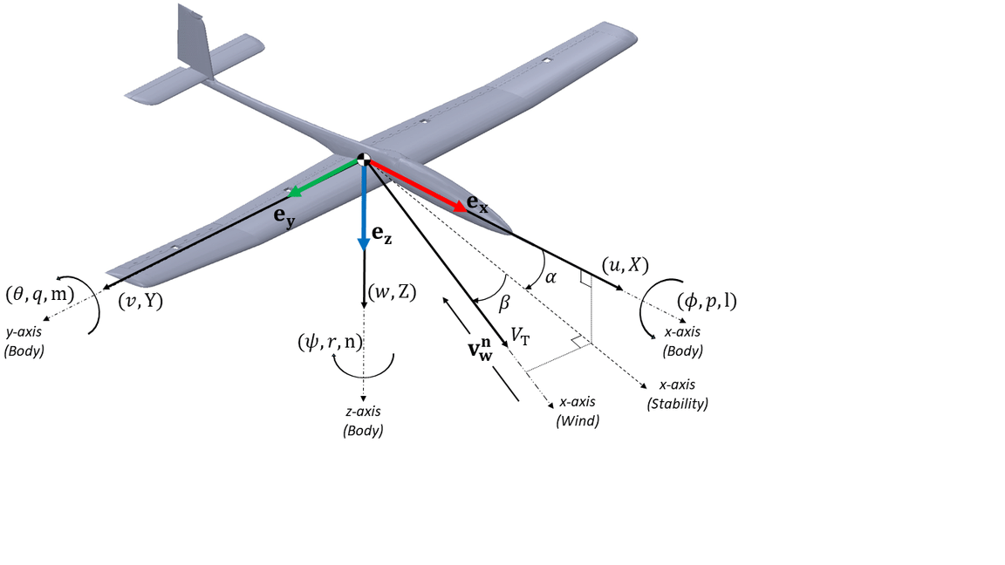



The additional EOM of airplanes:
$→$The effect of the control surfaces: $δ_{e}$ , $δ_{a}$ , $δ_{r}$ , $δ_{T}$
i- The change in forces:
$∆X=m \left(\frac{∂X}{∂u} ∆u+\frac{∂X}{∂w} ∆w+ \frac{∂X}{∂δ_{e}} ∆δ_{e}+ \frac{∂X}{∂δ_{T}} ∆δ_{T}\right)$
$∆Y=m \left(\frac{∂Y}{∂v} ∆v+\frac{∂Y}{∂β} ∆β+ \frac{∂Y}{∂δ_{a}} ∆δ_{a}+ \frac{∂Y}{∂δ_{r}} ∆δ_{r}\right)$
$∆Z=m \left(\frac{∂Z}{∂u} ∆u+\frac{∂Z}{∂w} ∆w+ \frac{∂Z}{∂\dot{w}} ∆\dot{w}+\frac{∂Z}{∂q} ∆q+ \frac{∂Z}{∂δ_{e}} ∆δ_{e}+ \frac{∂Z}{∂δ_{T}} ∆δ_{T}\right)$
ii- The change in moments:
$∆L=I_{xx} \left(\frac{∂L}{∂β} ∆β+\frac{∂L}{∂p} ∆p+\frac{∂L}{∂r} ∆r+ \frac{∂L}{∂δ_{r}} ∆δ_{r}+ \frac{∂L}{∂δ_{a}} ∆δ_{a}\right)$
$∆M=I_{yy} \left(\frac{∂M}{∂u} ∆u+\frac{∂M}{∂w} ∆w+ \frac{∂M}{∂\dot{w}} ∆\dot{w}+\frac{∂M}{∂q} ∆q+ \frac{∂M}{∂δ_{e}} ∆δ_{e}+ \frac{∂M}{∂δ_{T}} ∆δ_{T}\right)$
$∆N=I_{zz} \left(\frac{∂N}{∂β} ∆β+\frac{∂N}{∂p} ∆p+\frac{∂N}{∂r} ∆r+ \frac{∂N}{∂δ_{r}} ∆δ_{r}+ \frac{∂N}{∂δ_{a}} ∆δ_{a}\right)$
$→$We used RK4 to solve the equations numerically and compared the solution with ODE45
Notes:
*the difference between the relative wind angles alpha, bate vs body to fixed frame angles theta, psi.
*difference between stability derivatives and control derivatives.

Slide 6
TASK 2 RBD solver
6DOF
Initial Conditions
Forces
RBD Solver
Moments
Inertia & Mass
Solving
Solving state by state using RBD Solver
Appling RK4 in order to evaluate the next state.
Evaluation of 12 equation for given set of inputs
Verifying
Using Simulink (equations)
Using ode45 (integration)
Notes:
*code strategy
*was tested using constant forces and moments

Slide 7
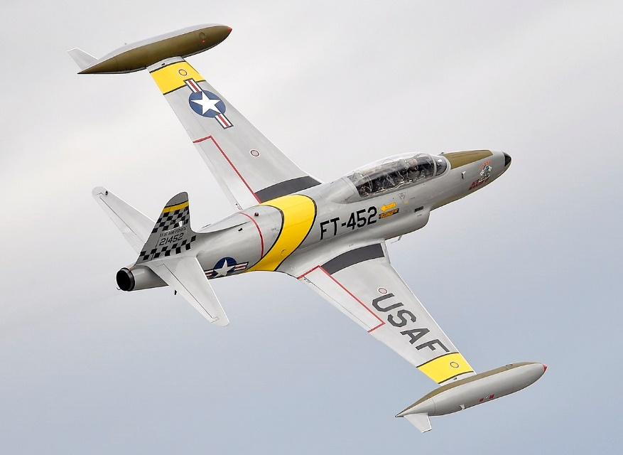
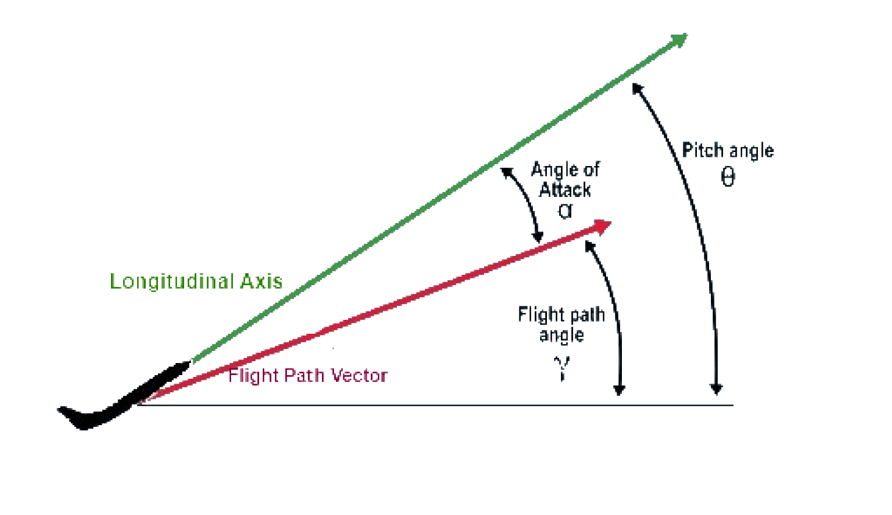


TASK 3 Non-linear simulator
The Forces & Moments aren’t constant any more, we linearized them so:
The X-Force will be $X=∆X+X_{o}$
Where using 1st order Taylor series expansion:
$${∆X}/m= \left(X_{u} ∆u+X_{w} ∆w+ X_{δ_{e}} ∆δ_{e}+ X_{δ_{th}} ∆δ_{th}\right) \& X_{o}=mgS_{θ_{o}}$$
Force & Moments are function of stability derivatives & actions of control surfaces
$X_{o}$ calculated from equilibrium equations at specific point(our FC)
NT-33A
$$θ_{0}=γ_{0}+α_{0}$$
$$α_{0}=\tan^{−1}{w/u}$$
$$β_{0}=\tan^{−1}{v/V}$$
Notes:
*the linearization is based on small perturbation theory about a stable point where aerodynamic forces and moments are in equilibrium with all other forces acting on the aircraft (gravity, thrust, drag).
*the transformation from dashed to undashed conditions.
*using the vector form to uncouple the equations.
*we should pass the initial conditions added to the perturbations in forces and moments.
*the weight vector is represented in the body axis using the Euler angles.

Slide 8

Benchmark test results
Response for ${+5}^{o}$ aileron

Slide 9

Response for ${+5}^{o}$ elevator

Slide 10



TASK 4 Full linearized model
Longitudinal full linearized model
$$\left[\begin{aligned}&Δ\dot{u} \\ &Δ\dot{w} \\ &Δ\dot{q} \\ &Δ\dot{θ}\end{aligned}\right]=\left[\begin{matrix}X_{u} & X_{w} & −w_{o} & −g \cos\left(θ_{o}\right) \\ \frac{Z_{u}}{\left(1−Z_{\dot{w}}\right)} & \frac{Z_{w}}{\left(1−Z_{\dot{w}}\right)} & \frac{\left(Z_{q}+u_{o}\right)}{\left(1−Z_{\dot{w}}\right)} & \frac{−g \sin\left(θ_{o}\right)}{\left(1−Z_{\dot{w}}\right)} \\ M_{u}+ M_{\dot{w}}\frac{Z_{u}}{\left(1−Z_{\dot{w}}\right)} & M_{w}+ M_{\dot{w}}\frac{Z_{w}}{\left(1−Z_{\dot{w}}\right)} & M_{q}+ M_{\dot{w}}\frac{\left(Z_{q}+u_{o}\right)}{\left(1−Z_{\dot{w}}\right)} & − M_{\dot{w}}∗\frac{g \sin\left(θ_{o}\right)}{\left(1−Z_{\dot{w}}\right)} \\ 0 & 0 & 1 & 0\end{matrix}\right]\left[\begin{aligned}&Δu \\ &Δw \\ &Δq \\ &Δθ\end{aligned}\right]+\left[\begin{matrix}X_{δ_{e}} & X_{δ_{th}} \\ \frac{Z_{δ_{e}}}{\left(1−Z_{\dot{w}}\right)} & \frac{Z_{δ_{th}}}{\left(1−Z_{\dot{w}}\right)} \\ M_{δ_{e}}+ M_{\dot{w}}\frac{Z_{δ_{e}}}{\left(1−Z_{\dot{w}}\right)} & M_{δ_{th}}+ M_{\dot{w}}\frac{Z_{δ_{th}}}{\left(1−Z_{\dot{w}}\right)} \\ 0 & 0\end{matrix}\right]\left[\begin{aligned}&∆δ_{e} \\ & ∆δ_{th}\end{aligned}\right]$$
Long period mode
$$\left[\begin{aligned}&\dot{u} \\ &\dot{θ}\end{aligned}\right]=\left[\begin{aligned}&\begin{aligned}&{ X}_{u}+\frac{w_{o}Z_{u}}{Z_{q}+u_{o}} −g\cos\left(θ_{o}\right)−\frac{w_{o}gsin\left(θ_{o}\right)}{Z_{q}+u_{o}}\end{aligned} \\ & \frac{−Z_{u}}{Z_{q}+u_{o}} \frac{gsin\left(θ_{o}\right)}{Z_{q}+u_{o}} \end{aligned}\right]\left[\begin{aligned}&u \\ &θ\end{aligned}\right]+\left[\begin{aligned}&{ X}_{δ_{e}}+\frac{w_{o}Z_{δ_{e}}}{Z_{q}+u_{o}} { X}_{δ_{th}}+\frac{w_{o}Z_{δ_{th}}}{Z_{q}+u_{o}} \\ & \frac{−Z_{δ_{e}}}{Z_{q}+u_{o}} \frac{−Z_{δ_{th}}}{Z_{q}+u_{o}} \end{aligned}\right]\left[\begin{aligned}& ∆δ_{e} \\ & ∆δ_{th}\end{aligned}\right]$$
Short period mode
$$\left[\begin{aligned}&\dot{α} \\ &\dot{q}\end{aligned}\right]=\left[\begin{aligned}&\frac{Z_{α}}{u_{o}} 1 \\ &M_{α}+\frac{{M_{\dot{α}} Z}_{α}}{u_{o}} M_{q}+M_{\dot{α}}\end{aligned}\right]\left[\begin{aligned}&α \\ &q\end{aligned}\right]+\left[\begin{aligned}&Z_{δ_{e}} Z_{δ_{th}} \\ &M_{δ_{e}}+\frac{{M_{α} Z}_{δ_{e}}}{u_{o}} M_{\dot{α}}+\frac{{M_{α} Z}_{δ_{th}}}{u_{o}}\end{aligned}\right]\left[\begin{aligned}& ∆δ_{e} \\ & ∆δ_{th}\end{aligned}\right]$$
Notes:
*linearization of both forces and moments and the rigid body equations
*the equations of long. And lat. Are decoupled neutrally after the linearization

Slide 11



Lateral full linearized model
$$\left[\begin{aligned}&Δ\dot{β} \\ &Δ\dot{p} \\ &Δ\dot{r} \\ &Δ\dot{φ} \\ &Δ\dot{ψ}\end{aligned}\right]=\left[\begin{matrix}\frac{Y_{β}}{V_{to}} & \frac{Y_{p}+w_{o}}{V_{to}} & \frac{Y_{r}−u_{o}}{V_{to}} & \frac{g\cos\left(θ_{o}\right)}{V_{to}} & 0 \\ L_{β}^{∗} & L_{p}^{∗} & L_{r}^{∗} & 0 & 0 \\ N_{β}^{∗} & N_{p}^{∗} & N_{r}^{∗} & 0 & 0 \\ 0 & 1 & \tan\left(θ_{0}\right) & 0 & 0 \\ 0 & 0 & \sec\left(θ_{0}\right) & 0 & 0\end{matrix}\right]\left[\begin{aligned}&Δβ \\ &Δp \\ &Δr \\ &Δφ \\ &Δψ\end{aligned}\right]+\left[\begin{matrix}\frac{Y_{δa}}{V_{to}} & \frac{Y_{δ_{r}}}{V_{to}} \\ L_{δ_{a}}^{∗} & L_{δ_{r}}^{∗} \\ ∆δ_{a} & N_{δ_{r}}^{∗} \\ 0 & 0 \\ 0 & 0\end{matrix}\right]\left[\begin{aligned}& ∆δ_{a} \\ & ∆δ_{r}\end{aligned}\right]$$
Dutch-Roll mode
$$\left[\begin{aligned}&Δ\dot{p} \\ &Δ\dot{r} \\ &Δ\dot{φ}\end{aligned}\right]=\left[\begin{matrix}\grave{L_{p}} & \grave{L_{r}} & 0 \\ \grave{N_{p}} & \grave{N_{r}} & 0 \\ 1 & \tan\left(θ_{o}\right) & 0\end{matrix}\right]\left[\begin{aligned}&Δp \\ &Δr \\ &Δφ\end{aligned}\right]+\left[\begin{aligned}&\acute{{ L}_{δ_{r}}} \\ & \acute{{ N}_{δ_{r}}} \\ & 0 \end{aligned}\right]\left[\begin{aligned}& ∆δ_{r}\end{aligned}\right]$$
spiral mode
$$\left[\begin{aligned}&Δ\dot{β} \\ &Δ\dot{r}\end{aligned}\right]=\left[\begin{aligned}&Y_{v} \frac{Y_{r}−1}{V_{to}} \\ &\grave{N_{β}} \grave{N_{r}} \end{aligned}\right]\left[\begin{aligned}&Δβ \\ &Δr\end{aligned}\right]+\left[\begin{aligned}&{{ Y}_{δ_{a}}}^{∗} {{ Y}_{δ_{r}}}^{∗} \\ &\acute{{ N}_{δ_{a}}} \acute{{ N}_{δ_{r}}}\end{aligned}\right]\left[\begin{aligned}& ∆δ_{a} \\ & ∆δ_{r}\end{aligned}\right]$$
Roll mode
$$\dot{P}−L_{p}′p=L_{δa}′δ_{a}$$

Slide 12
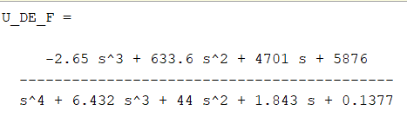
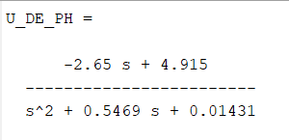

Root locus and bode plot of $u/δ_{e}$ for full linear and long period approximation.
Notes:
*we linearize the equations to get the transferer functions to use during the design of our controller
*we are using the TF from the fully linearized model

Slide 13
Linearized, Approximations, and Non-linear model results comparison
Longitudinal
Lateral

Slide 14
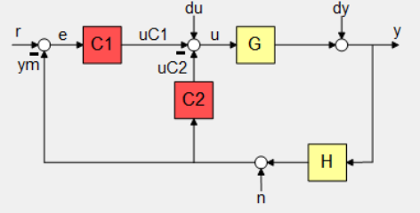
Pitch controller
TASK 5 Long. controller
PD_tf =
0.085498 s
Name: C2
PI_tf =
0.75333 (s+0.6555)
------------------
s
Name: C1
THETA_DE_F =
-52.7 s^2 - 184.8 s - 7.413
-------------------------------------------
s^4 + 6.432 s^3 + 44 s^2 + 1.843 s + 0.1377
OL_theta_thetacom =
527 s^2 + 1848 s + 74.13
---------------------------------------------------------
s^5 + 16.43 s^4 + 108.3 s^3 + 441.9 s^2 + 18.57 s + 1.377
Notes:
*we used the complementary root locus as the dc gain of the theta/de was negative so the right real axis had a root locus on it.
*we used positive feed back to over come the root locus on the right real axis.
*pitch from elevator.
*the given block diagram is equivalent to the PID controller when the input 1st derivative is zero(step, impulse) only; representing the PID this way allows us to show the control action.

Slide 15
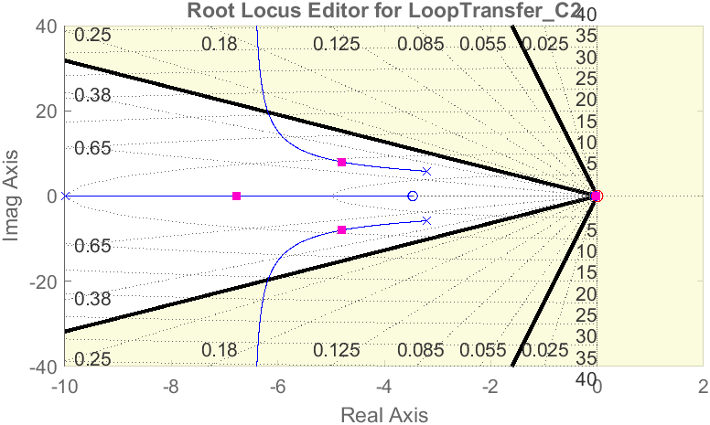

Design constraints
according to cooper harper qualities (level 1):
Long period mode constraint
$ζ>0.04$
Short period constraint:
$$0.3<ζ<2$$

Slide 16
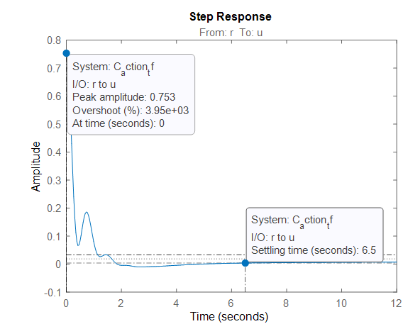


Results
$$o.s=12.8\%$$
$$T_{s}=4.36 sec$$
$${δ_{max}/θ}_{max}=0.753$$
$$for θ_{max}=15° δ_{max}=11.295°$$
Notes:
*

Slide 17
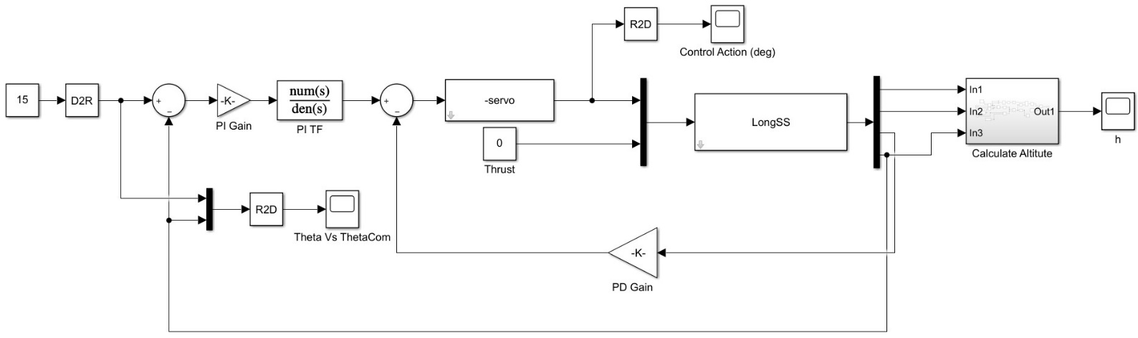
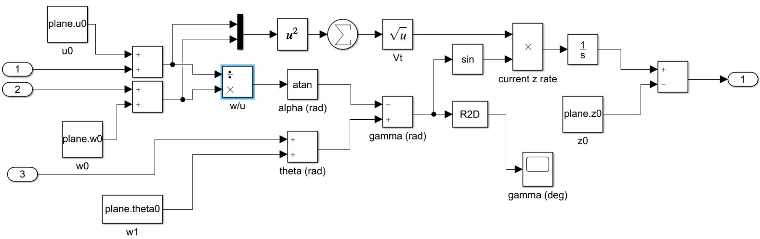
Simulink results
Notes:
*explanation of the continues increase in altitude danbaite the theta command.

Slide 18
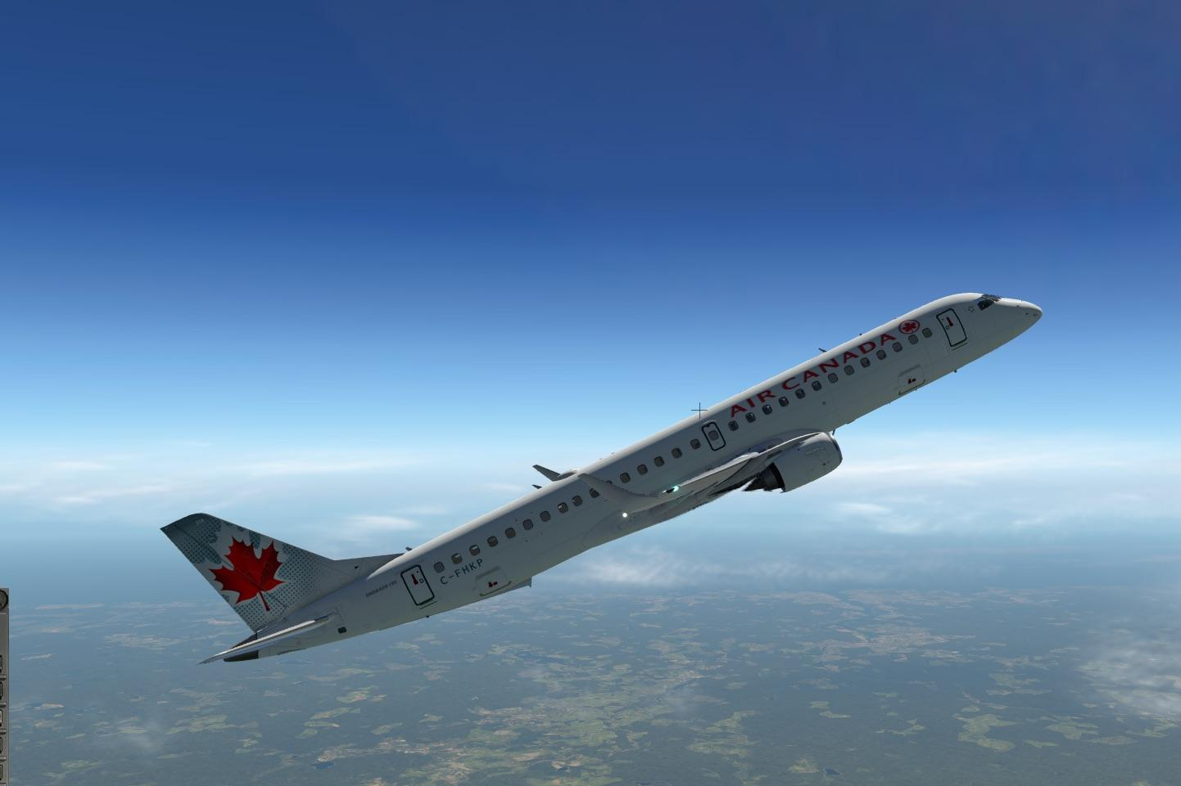
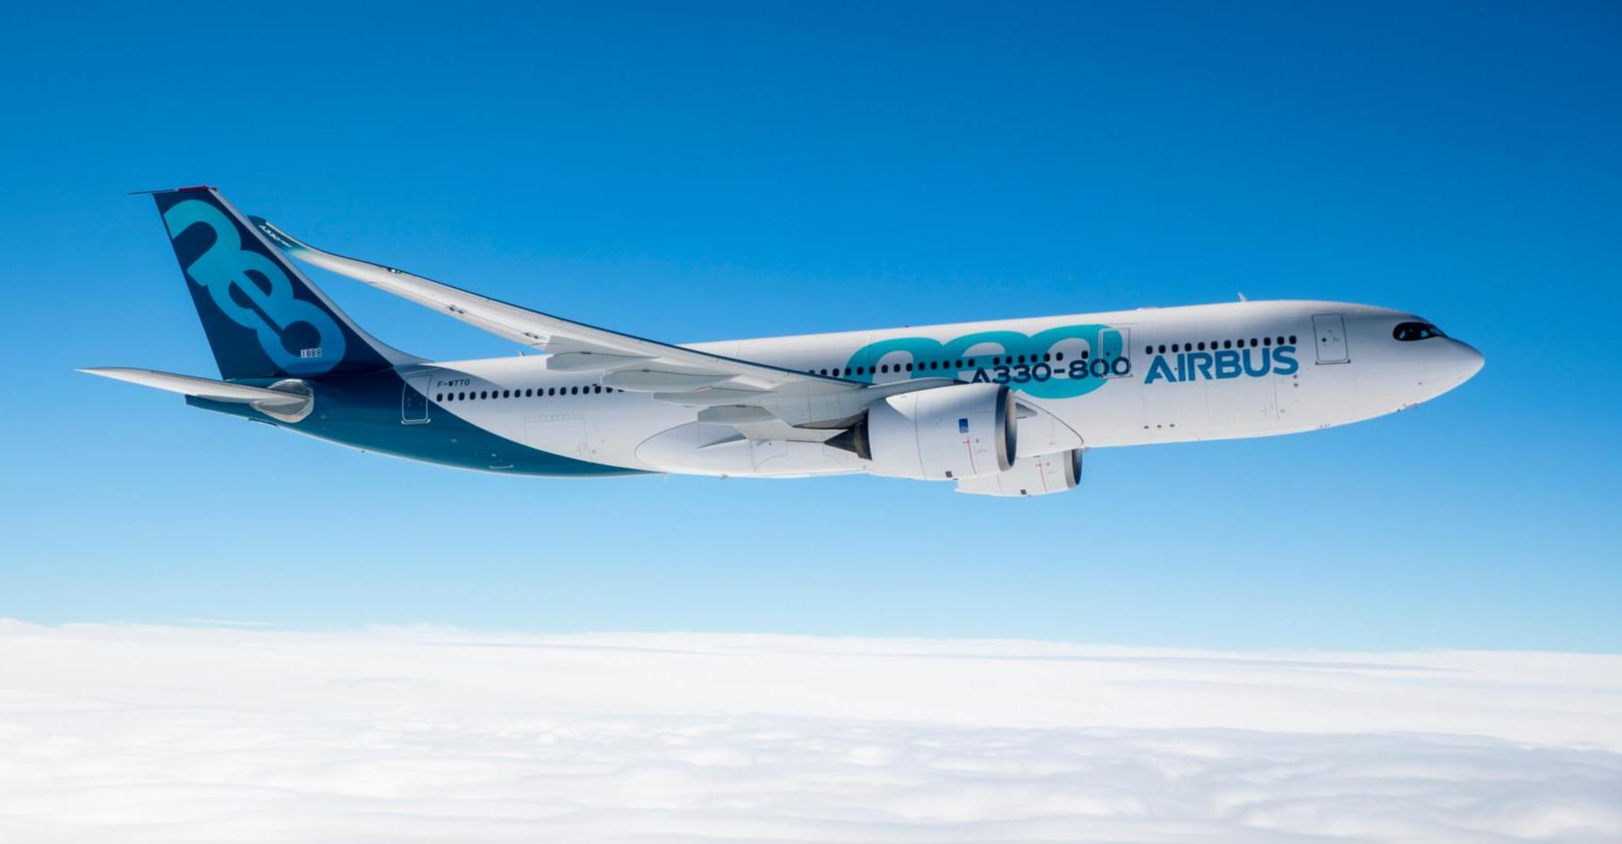
Necessity of Velocity Control
In normal flight there is almost no weight component in the thrust direction; In case of giving a pitch angle a weight component in the thrust direction grows gradually.
If the pitch angle is not high enough to make the weight component overcoming the thrust component, the plane will keep increasing in height. Otherwise; the plane will instantaneously gain height then it will dive down even if the pitch angle was positive.
Case 2
Case 1

Slide 19
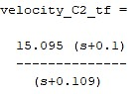
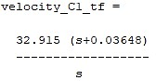
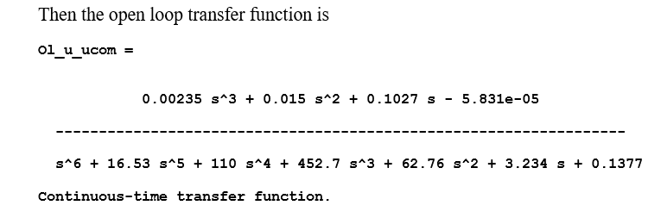

Velocity controller
$u/δ_{th}$=
0.00235 s^3 + 0.015 s^2 + 0.1027 s - 5.831e-05
----------------------------------------------
s^4 + 6.432 s^3 + 44 s^2 + 1.843 s + 0.1377
Notes:
*velocity from thrust.
*we added a zero on the engine time lag pole performing a pole zero cancelation to improve the settling time.
*The ol_u_com is the open loop TF after accounting for servo and engine dynamics.

Slide 20

Results
$$o.s=13.7\%$$
$$T_{s}=436 sec$$
The Powerplant installed produces 4,600 lbf (20,461.82 N) maximum continuous thrust.

Slide 21
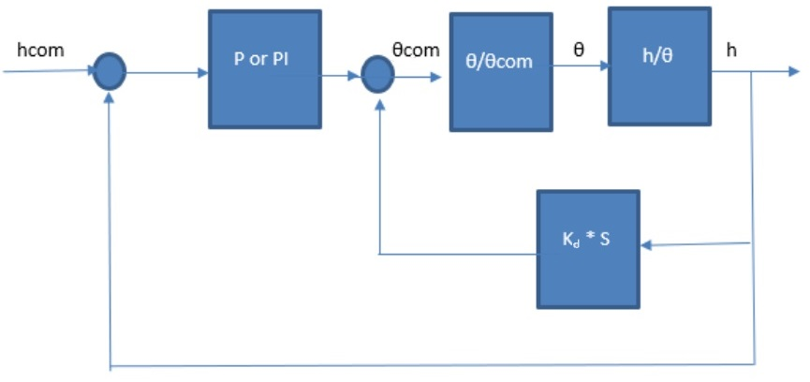
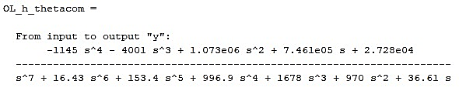
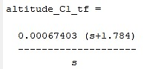
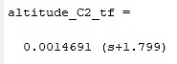
Altitude controller
Notes:
*mineral
*Hight from pitch

Slide 22

Results
$$o.s=0$$
$$T_{s}=6.98 sec$$

Slide 23
Simulink results for height and velocity controllers

Slide 25
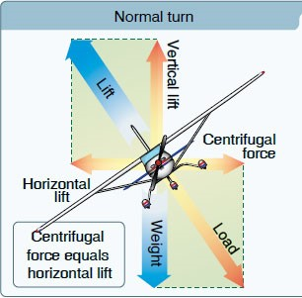

Purpose of lateral controller
TASK 6 lat. controller
To achieve a successful coordinated turn we must eliminate any slipping or skidding: $β=0$ while controlling the aircraft heading.
By adding the longitudinal controller we can make a coordinated level turn which means keeping the altitude while turning.

Slide 26
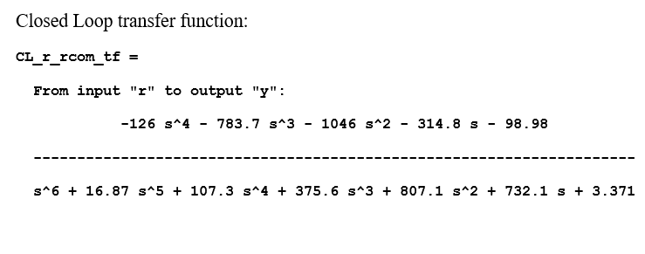

Yaw damper
$r/δ_{r}$=
-12.6 s^3 + 784.5 s^2 + 3775 s - 6.762
----------------------------------------------
s^4 + 5.409 s^3 + 15.12 s^2 + 49.26 s + 0.2303
WASH OUT CIRCUIT (H) =
0.12324 s
--------------------------
s+1.464
Notes:
*the washout circuit is a high pass filter which allows passing a constant value of r (psi_dot) so we can turn.

Slide 27
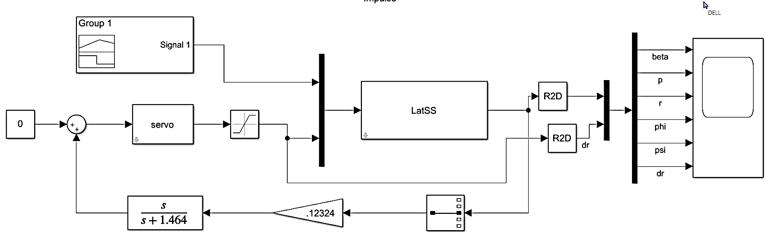

O$.S=−8.31$
$$T_{s}=4.48 sec$$

Slide 29
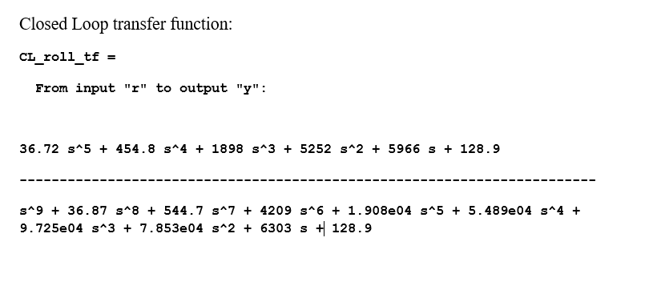

Roll controller
$φ/δ_{a}$ (G)=
4700 s^4 + 5.811e04 s^3 + 2.417e05 s^2 + 6.669e05 s + 7.489e05
--------------------------------------------------------------------------------------------------------
s^8 + 36.87 s^7 + 544.7 s^6 + 4209 s^5 + 1.905e04 s^4 + 5.443e04 s^3 + 9.535e04 s^2 + 7.327e04 s + 337.1
0.0078128 (s+0.02203)
C= -----------------------------
s

Slide 30

O$.S=−8.31$
$$T_{s}=4.48 sec$$

Slide 31
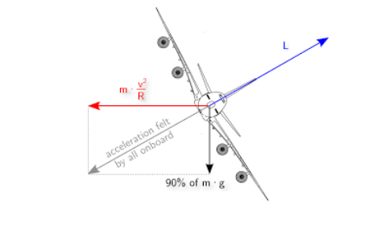
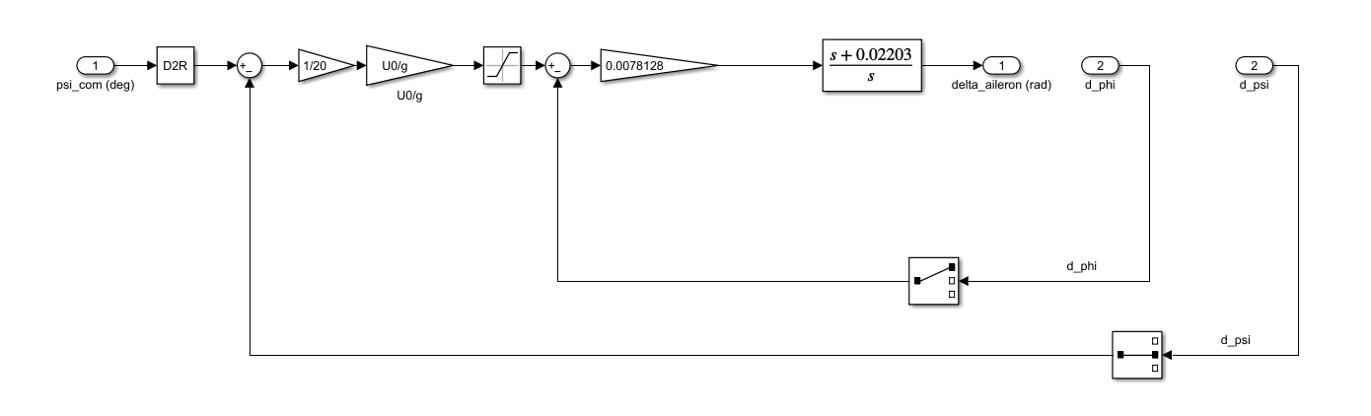


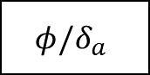
Coordination “head controller”
Let $τ=20, { ψ}_{d}=360$
$$ψ_{d}$$
$$φ/δ_{a}$$
$$φ/ψ$$

Slide 32
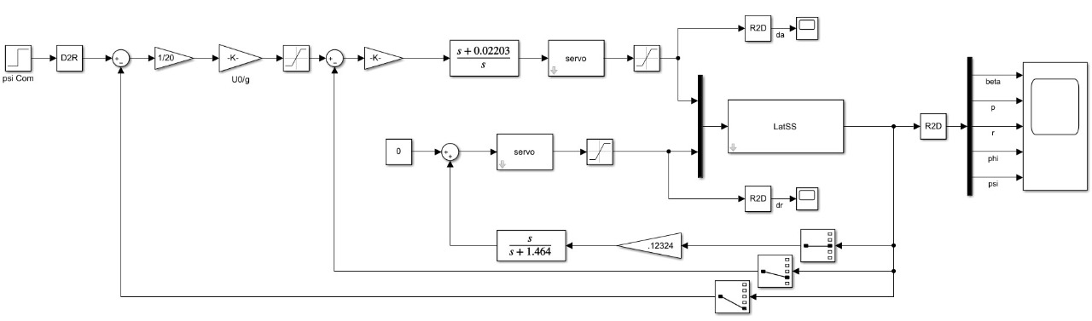

Slide 33
$$o.s=no over shoot as we assumed the psi responce dynamics to be simple lag$$
$$T_{s}=290 sec$$

Slide 34
TASK 7 controllers on the non-linear simulator
This task is depending on the comparison between lineal and non-linear simulators for the two portions of autopilot controller.
Lateral Autopilot
Longitudinal
Autopilot
Autopilot Controller

Slide 35
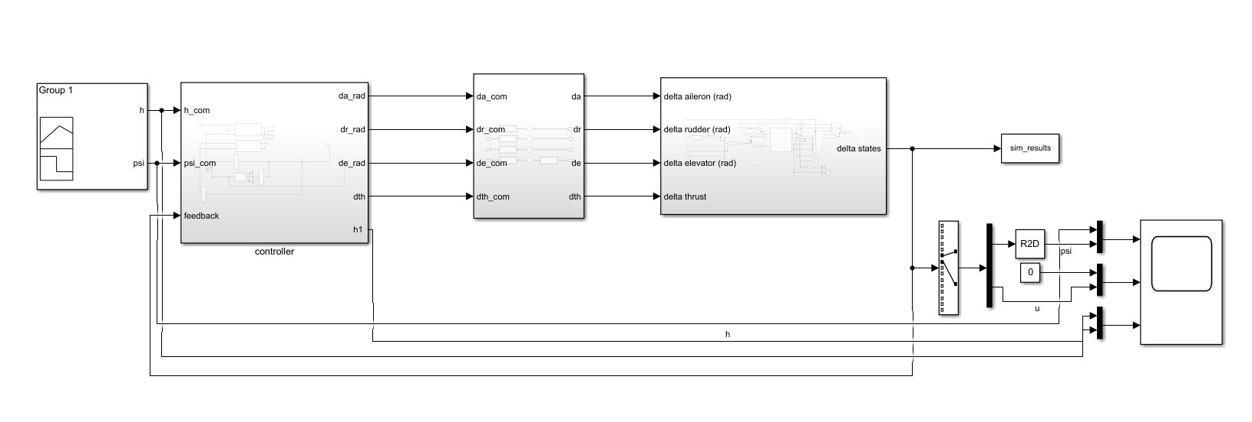
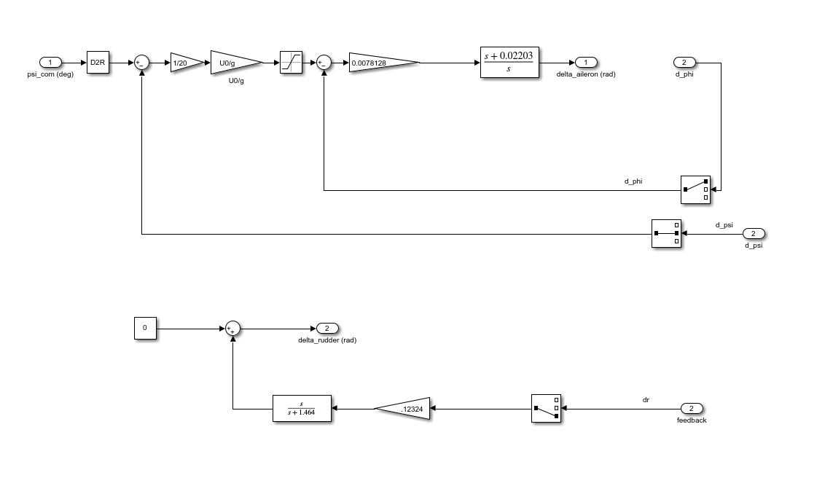
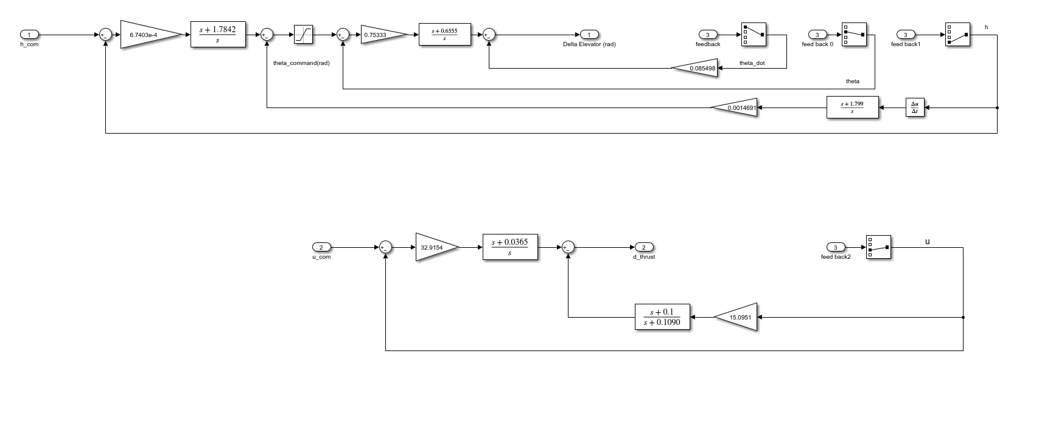
Non-linear simulator
Lat. controller
long. controller
Height from pitch, pitch from elevator
Heading from roll
Roll from aileron
Yaw damper, r from rudder
Velocity (u) from thrust
Notes:
*altitude controller (velocity_controller+hight from pitch)
*lateral controller (yaw damper+ heading from roll)

Slide 36
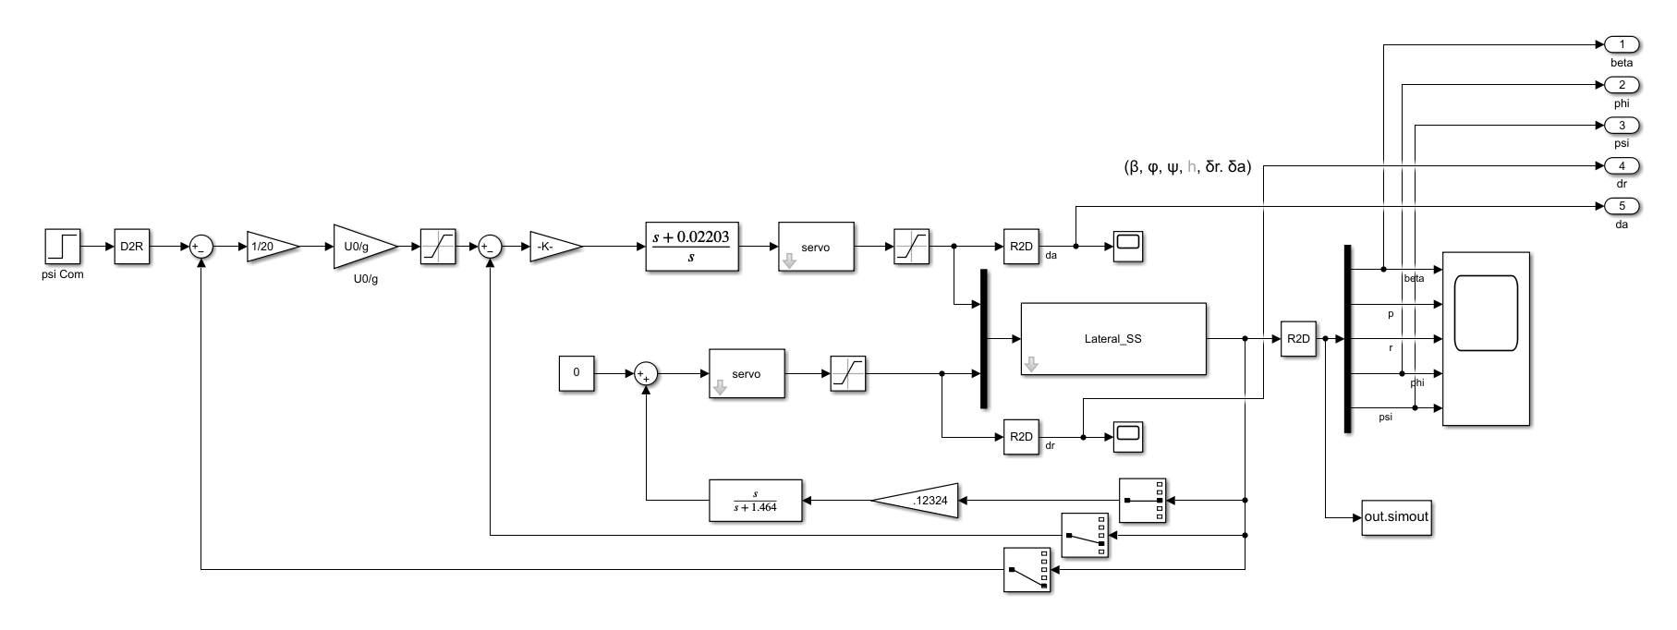
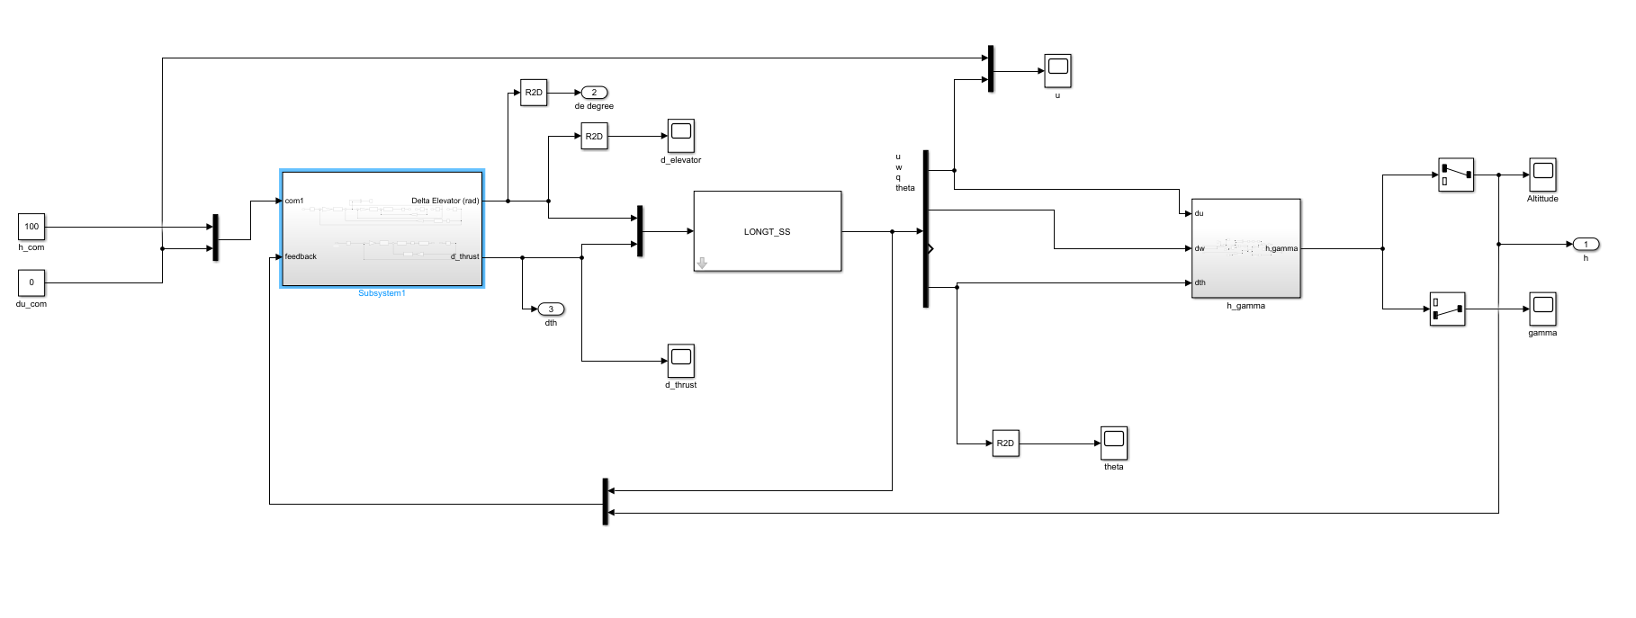
Linear simulator
Long. linear model
Lat. linear model

Slide 37
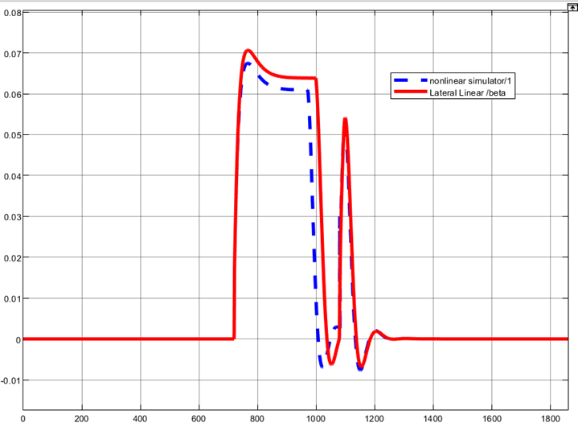
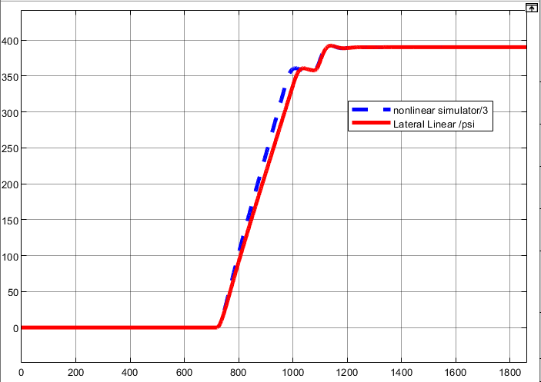
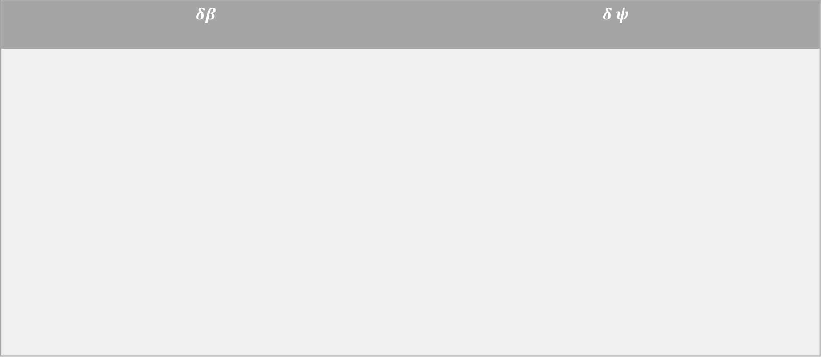
Results
We went through the whole process of the validation of each controller but here we’re showing the results of the system with all controllers.
$$δβ$$ | $$δ ψ$$

Slide 38
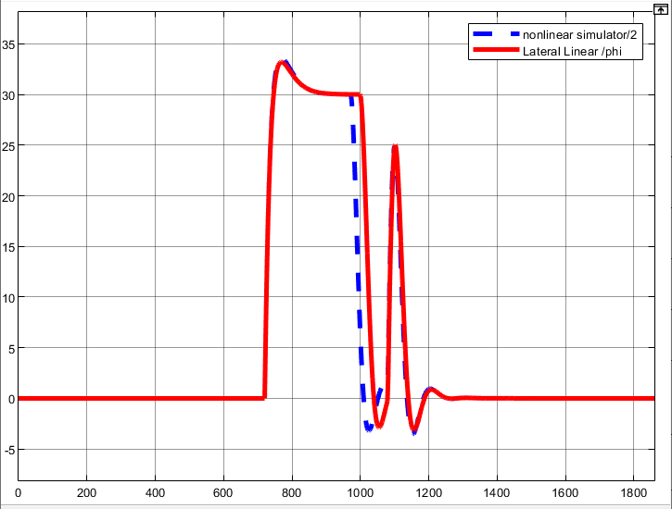
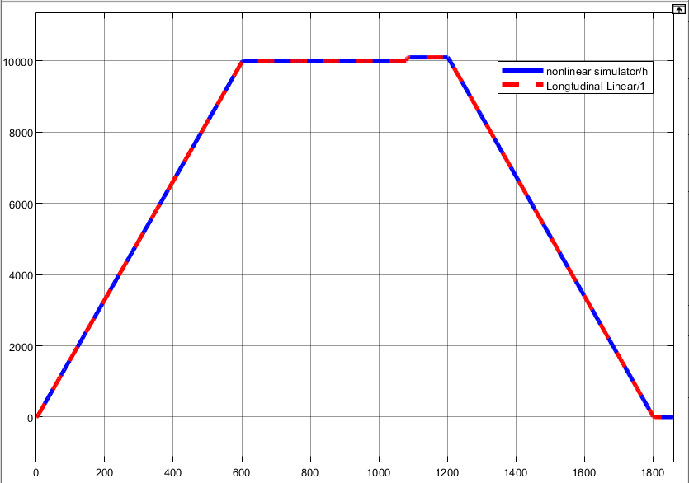

$$δφ$$ | $$δ h$$

Slide 39
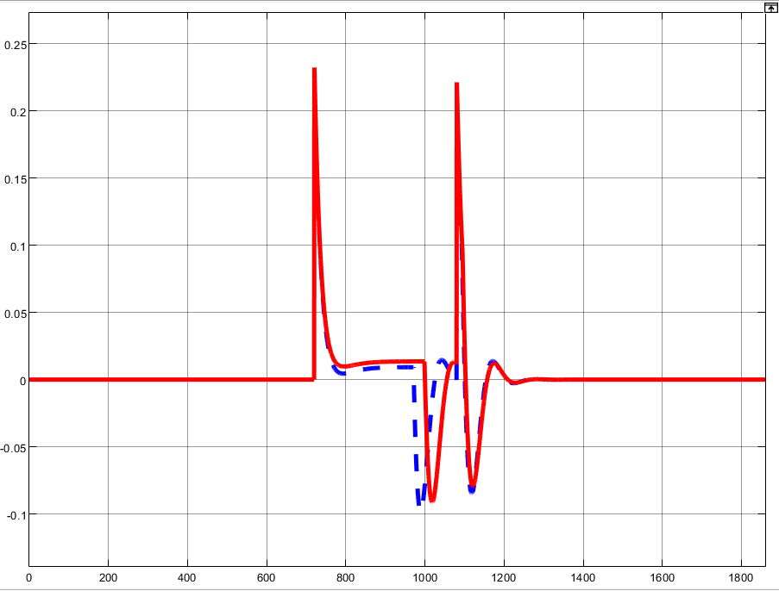
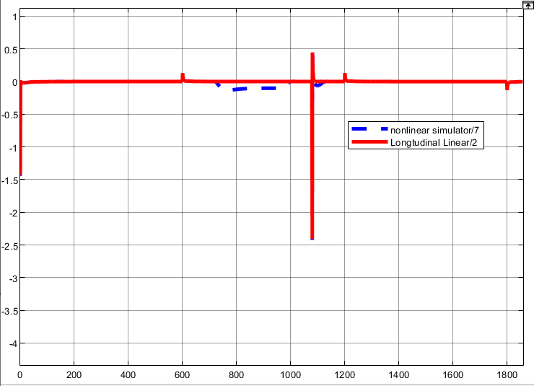

$$δa$$ | $$δ e$$

Slide 40
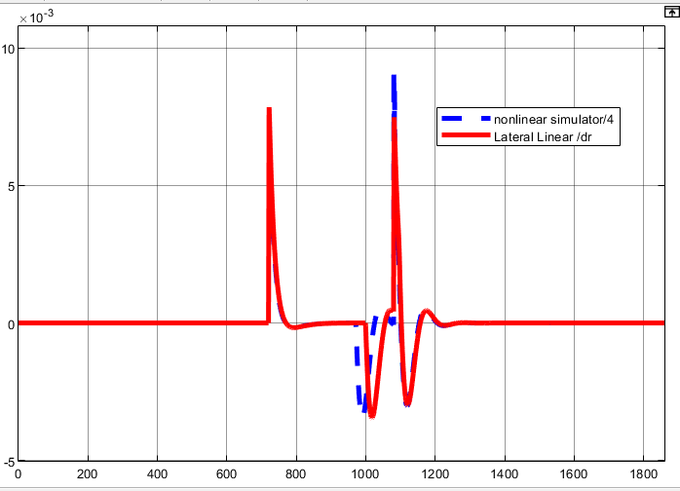
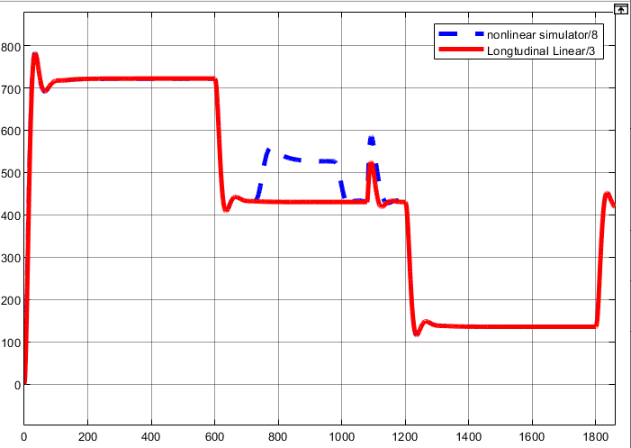

$$δr$$ | $$δ Th$$

Slide 43

Comment on the results of $δ_{u}$ for huge pitch command
$$θ_{com}=33.5°$$

Slide 44
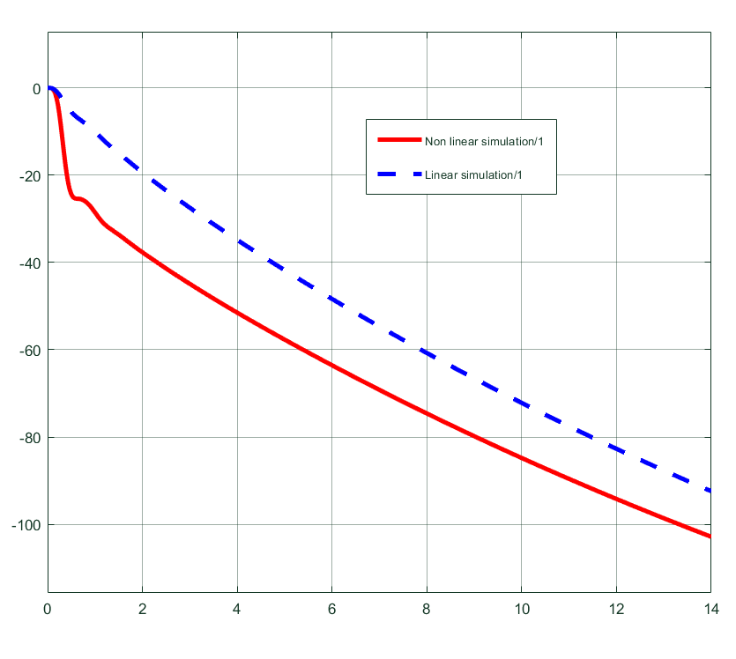
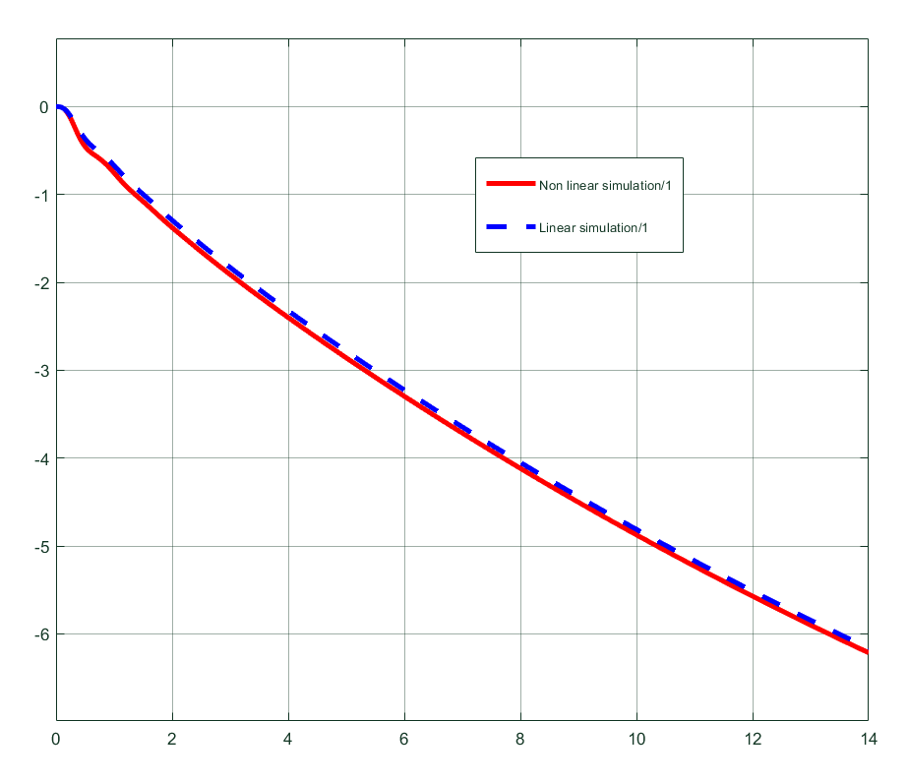

$$θ_{com}=15°$$
$$θ_{com}=1°$$

Slide 45
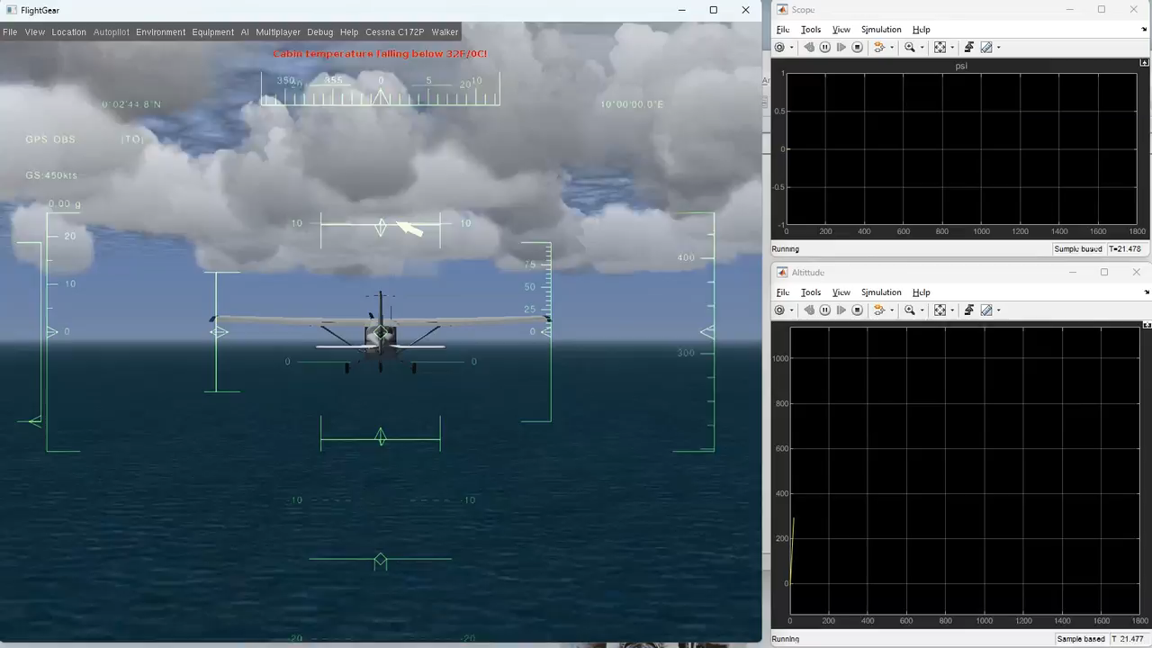

Slide 46
Thanks

